Slide 1
Netdisco & LibreNMS
Web-based Network Monitoring
By Gilbert Detillieux, 11 Jan 2022 MUUG Meeting

Slide 2
About me…
First exposed to UNIX at U of M in 1979,
worked on it starting in 1980
Worked in industry from 1983 to 1989,
trying to focus on UNIX support
Began current job as a SysAdmin
in October 1989 (32+ years ago)
Focused on UNIX/Linux, primarily
Secondary focus on LAN admin
  Managed switches from multiple vendors

Slide 3
Early Network Monitoring
Unix commands:
  ifconfig, route, ping, traceroute, etc.
Arpwatch
NMAP
SNMP and MRTG
  Presentations at MUUG meetings in
  January 2001 and September 2002
  Crude by today’s standards
  Lots of manual configuration involved
Would like a more automated, integrated solution

Slide 4
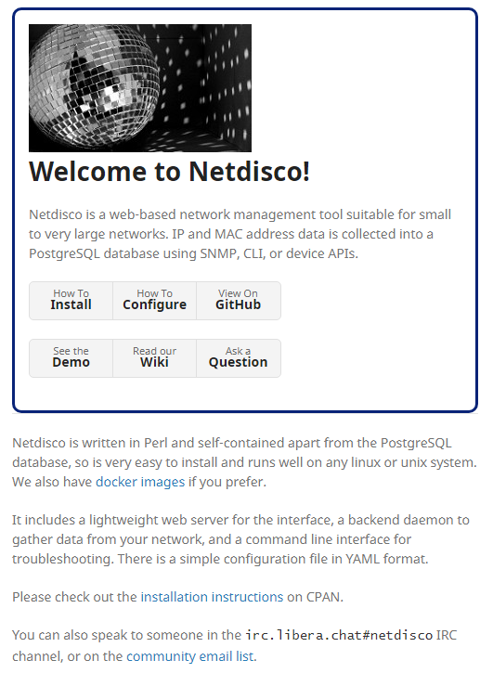
Source: http://netdisco.org/

Slide 5
Source: http://netdisco.org/

Slide 6
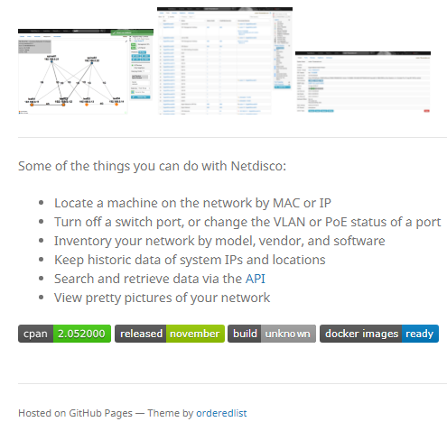
Source: http://netdisco.org/

Slide 7
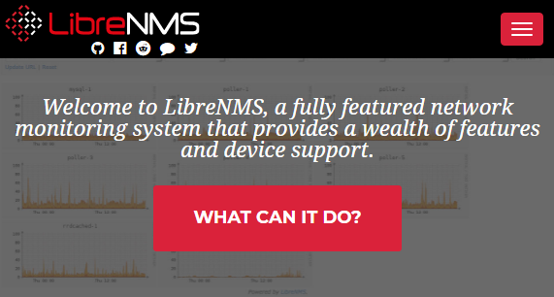
Source: https://www.librenms.org/

Slide 8
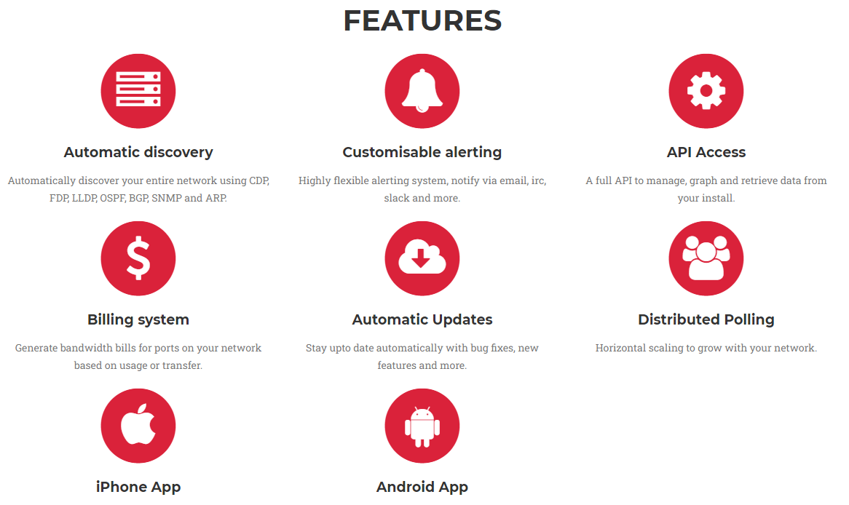
Source: https://www.librenms.org/

Slide 9
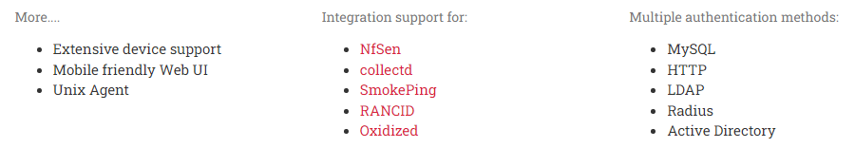
Source: https://www.librenms.org/

Slide 10
What they have in common:
Web-based GUI
Use SNMP, ARP and network discovery protocols (e.g. LLDP, CDP, FDP, etc.)
  Back-end (daemon) processes to collect data
  Back-end database to store current state and history
Fairly extensive online documentation
  Including good installation and configuration guides
Online demos available
Manual installation process, lots of commands
Docker images available

Slide 11
Netdisco features/strengths:
Network-centric view of things
Good at showing where devices are connected
  E.g. switch port where a MAC or IP address found
  Network topology map
Works well with Cisco hardware, not as well with some others (e.g. Juniper, TP-Link)
All back-end code is in Perl – more portable
  E.g. Ubuntu/Debian, RH/Fedora, openSUSE, and BSD
Simpler installation (a bit)
Back-end database must be PostgreSQL

Slide 12
Netdisco GUI features/strengths:
Clean, simple GUI, with JS support code
Run its own mini web server on port 5000
No HTTPS or address restrictions, but…
  https://blog.mgauto.me/post/installing-netdisco/
  (see step 7 for Ubuntu/Apache SSL Proxy setup)
  See also https://github.com/netdisco/netdisco/wiki/Install-Tips#behind-a-proxy (for Apache Proxy setup)

Slide 13
Netdisco demo:
Public demo:
https://netdisco2-demo.herokuapp.com/
  Inventory vs Device/Inventory by Model by OS
  Device/Addresses without DNS Entries
  Device Details, Ports & Neighbors tabs
  Port/Ports with multiple nodes attached
  IP/IP Inventory & IP/Subnet Utilization
“Live” demo (UM CS site)
  Node/Node Vendor Inventory
Review https://metacpan.org/pod/App::Netdisco installation/configuration guide

Slide 14
LibreNMS features/strengths:
A more host-centric view
Good at showing/graphing resource usage
  Does deep dive using SNMP
  Includes display of a lot of vendor-specific MIB info
Back-end code is mostly PHP, and a bit of Python
Back-end DB is MariaDB (MySQL)
Fairly portable, but install instructions only for:
  Ubuntu 20.04 (nginx or Apache)
  RHEL / CentOS 8 (nginx or Apache)
  Debian 11 (nginx only?!)
  Docker and VM images
Old install docs for some older distros (obsolete)

Slide 15
LibreNMS demo:
Public demo: https://demo.librenms.org/
  Overview/Dashboard/Default
  Overview/Maps/Availability & Overview/Outages
  Devices/All Devices/Network & …/Server
  Health/Memory & other tabs…
  Top (global) tabs vs Device-specific tabs
“Live” demo (MUUG and UM CS site)
  Apps/Overview & other tabs…
  Printers (Health/Count & …/Toner tabs)
  Raspberry Pi Sensors (Health/State, Hum. & Temp. tabs)
Review Installation & Config
  https://docs.librenms.org/Installation/Install-LibreNMS/
  https://docs.librenms.org/Extensions/Applications/
  https://github.com/librenms/librenms-agent/tree/master/snmp

Slide 16

Which one is right for you?
Netdisco if you’re a Network Admin
(or most interested in network details)
LibreNMS if you’re a SysAdmin
(or most interested in host-specific details, or graphs of traffic levels & other resources)
Ralph:
“I think...both.”
- Groundhog Day

Slide 17

Questions?
Except where otherwise noted, all content in this presentation is licensed under a Creative Commons “Attribution-ShareAlike 2.5 Canada” License.
http://creativecommons.org/licenses/by-sa/2.5/ca/deed.en_CA
UNIX is a registered trademark of The Open Group

